Slide 1
LIBRARY MANAGEMENT SYSTEM
Name: A.SOWMYA
Course/Branch: CSE(AI&ML)
Year: 3rd Year
College: CMR Institute of Technology
Internship organization:INFO BHARATH
INTERNS
Technology: Java
Submission Date:10/09/2026

Slide 2
Introduction
The Library Management System is a console-based Java application developed as part of my Java internship project. The main purpose of this project is to simplify basic library operations such as adding books, viewing available books, borrowing books, returning books, and searching for books.
The project is designed using core Object-Oriented Programming concepts in Java. It uses classes, objects, ArrayList collections, methods, and basic exception handling to manage book and borrower information.
This beginner-level project helped me understand how Java programming concepts can be applied to develop a simple real-world application.

Slide 3
Project Objectives
The main objectives of the Library Management System are:
  To develop a simple console-based application using Java.
  To practice Object-Oriented Programming concepts.
  To maintain book records using Java classes and collections.
  To manage borrower information.
  To implement book borrowing and returning functionality.
  To check book availability before issuing a book.
  To provide a search facility based on book title or author.
  To handle invalid inputs and non-existent book or borrower IDs.
  To improve practical understanding of Java programming and data handling.

Slide 4
Technologies Used
Technology | purpose
Java | Main programming language
VS code | Development environment
ArrayList | Storing books and borrowers
Scanner | Taking user input
GitHub | Source code management
Git | Version control

Slide 5
System Features
Add Book
The Add Book feature allows the librarian to enter a Book ID, title, and author name. The book is then stored in an ArrayList and is initially marked as available.
View Books
The View Books feature displays all books stored in the system along with their Book ID, title, author, and current availability status.
Borrow Book
The Borrow Book feature allows a borrower to borrow an available book. Before issuing the book, the system checks whether the book exists and whether it is currently available.
Return Book
The Return Book feature allows a borrower to return an issued book. After the book is returned,

Slide 6
its availability status is changed back to available.
Search Book
Users can search for books using the book title or author's name. The system displays matching books and their availability status.
Error Handling
The system handles invalid inputs such as incorrect numeric values, non-existent Book IDs, duplicate Book IDs, and attempts to borrow books that have already been issued.

Slide 7
System Design
BOOK:
Book
│
├── Bookid
├── Title
├── Author
└── Availability
BORROWER:
Borrower
│
├── Borrowerid
├── Name
└── List of Borrowed Books

Slide 8
MAIN CLASS
LibraryManagementSystem
│
├── Add Book
├── View Books
├── Borrow Book
├── Return Book
└── Search Book

Slide 9
OOPS Concepts Used
Concept
How it is used
Book, Borrower, LibraryManagementSystem
Book and Borrower objects Private fields with getters/setters
Initializes Book and Borrower objects
ArrayList stores books and borrowers
Separate methods for each operation
Class
Object
Encapsulation
Constructor
Collection
Methods
Exception Handling
Handles invalid numeric input

Slide 10
Program Workflow
import java.util.ArrayList;
import java.util.Scanner;
class Book {
int bookID;
String title;
String author;
boolean availability;
Book(int id, String t, String a) {
bookID = id;
title = t;
author = a;
availability = true;
}
}
class Borrower {
int borrowerID;
String name;
ArrayList<Integer> borrowedBooks = new ArrayList<>();
Borrower(int id, String n) {
borrowerID = id;
name = n;
}
}

Slide 11
public class Main {
static Scanner sc = new Scanner(System.in);
static ArrayList<Book> books = new ArrayList<>();
static ArrayList<Borrower> borrowers = new ArrayList<>();
static Book findBook(int id) {
for (Book b : books)
if (b.bookID == id) return b;
return null;
}
static Borrower findBorrower(int id) {
for (Borrower b : borrowers)
if (b.borrowerID == id) return b;
return null;
}
static void addBook() {
System.out.print("Book ID: ");
int id = sc.nextInt();
sc.nextLine();
if (findBook(id) != null) {
System.out.println("Book ID already exists!");
return;
}
System.out.print("Title: ");
String title = sc.nextLine();
System.out.print("Author: ");
String author = sc.nextLine();
books.add(new Book(id, title, author));
System.out.println("Book added successfully!");
}

Slide 12
static void viewBooks() {
if (books.isEmpty()) {
System.out.println("No books available.");
return;
}
for (Book b : books) {
System.out.println("\nID: " + b.bookID);
System.out.println("Title: " + b.title);
System.out.println("Author: " + b.author);
System.out.println("Status: " +
(b.availability ? "Available" : "Issued"));
}
}
static void borrowBook() {
System.out.print("Borrower ID: ");
int id = sc.nextInt();
sc.nextLine();
Borrower br = findBorrower(id);
if (br == null) {
System.out.print("Borrower Name: ");
String name = sc.nextLine();
br = new Borrower(id, name);
borrowers.add(br);
}
System.out.print("Book ID: ");
int bookID = sc.nextInt();
Book b = findBook(bookID);

Slide 13
if (b == null) {
System.out.println("Book not found!");
} else if (!b.availability) {
System.out.println("Book is already issued!");
} else {
b.availability = false;
br.borrowedBooks.add(bookID);
System.out.println("Book borrowed successfully!");
}
}
static void returnBook() {
System.out.print("Borrower ID: ");
int id = sc.nextInt();
Borrower br = findBorrower(id);
if (br == null) {
System.out.println("Borrower not found!");
return;
}
System.out.print("Book ID: ");
int bookID = sc.nextInt();
Book b = findBook(bookID);
if (b == null) {
System.out.println("Book not found!");
} else if (!br.borrowedBooks.contains(bookID)) {
System.out.println("This borrower did not borrow this book!");
} else {
b.availability = true;
br.borrowedBooks.remove(Integer.valueOf(bookID));

Slide 14
System.out.println("Book returned successfully!");
} }
static void searchBook() {
sc.nextLine();
System.out.print("Enter title or author: ");
String s = sc.nextLine().toLowerCase();
boolean found = false;
for (Book b : books) {
if (b.title.toLowerCase().contains(s) ||
b.author.toLowerCase().contains(s)){
System.out.println(b.bookID + " - " +
b.title + " - " + b.author);
found = true;
} }
if (!found)
System.out.println("Book not found!“);
}
public static void main(String[] args) {
while (true) {
System.out.println("\n===== LIBRARY MANAGEMENT SYSTEM =====");
System.out.println("1. Add Book");
System.out.println("2. View Books");
System.out.println("3. Borrow Book");
System.out.println("4. Return Book");
System.out.println("5. Search Book");
System.out.println("6. Exit");
System.out.print("Enter choice: ");
int choice = sc.nextInt();

Slide 15
switch (choice) {
case 1:
addBook();
break;
case 2:
viewBooks();
break;
case 3:
borrowBook();
break;
case 4:
returnBook();
break;
case 5:
searchBook();
break;
case 6:
System.out.println("Thank you!");
return;
default:
System.out.println("Invalid choice!");
}
}
}
}

Slide 16
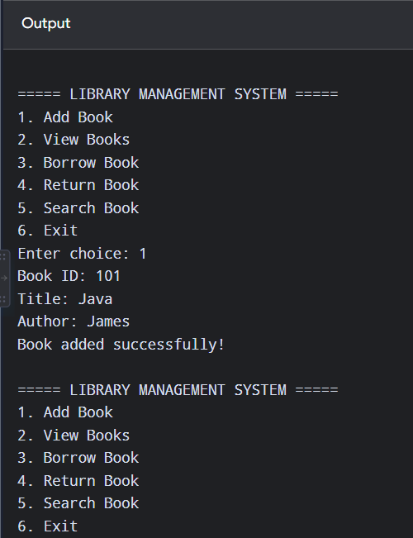
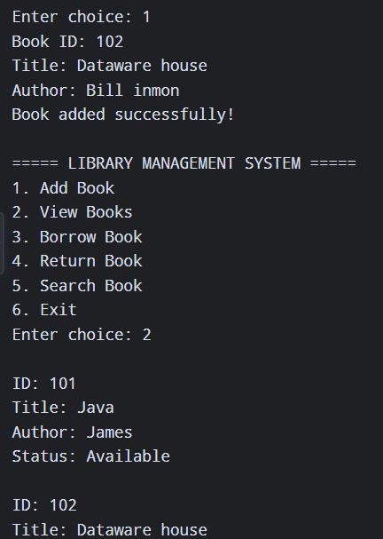
OUTPUT

Slide 17
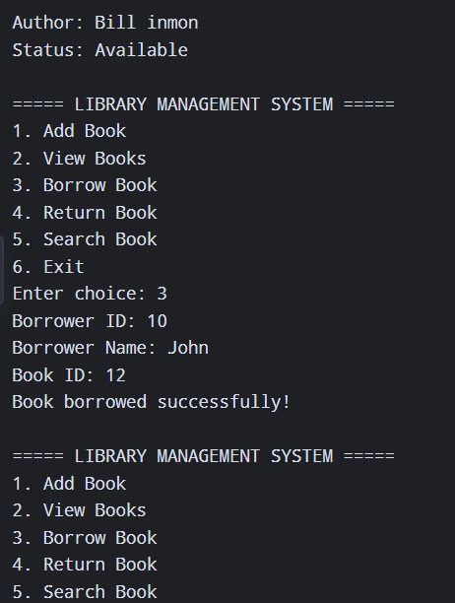
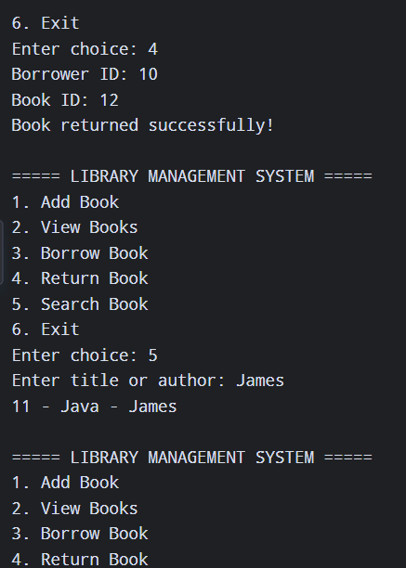

Slide 18
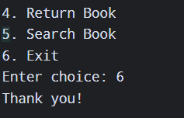

Slide 19
Challenges Faced
During the development of the project, I faced a few challenges, especially while working with multiple Java classes and maintaining relationships between books and borrowers.
Understanding how ArrayList works and how objects can be stored inside collections was one of the initial challenges. I also learned how to check book availability before allowing a borrowing transaction.
Handling invalid user input was another challenge. I implemented basic exception handling to prevent the program from terminating when the user enters an invalid number.
These challenges helped me improve my understanding of Java programming and problem-solving.

Slide 20
Learning Outcomes
Developing a Java console application.
Understanding Object-Oriented Programming concepts.
Creating classes and objects.
Using constructors, getters, and setters.
Working with ArrayList collections.
Implementing methods for different operations.
Performing basic input validation.
Handling exceptions in Java.
Managing relationships between objects.
Testing a program using different test cases.
Organizing source code for a GitHub repository.
Using GitHub for project submission and version control.

Slide 21
Future Enhancements
Database connectivity using MySQL.
A graphical user interface using JavaFX or Swing.
User login and authentication.
Admin and student roles.
Book due dates.
Automatic fine calculation.
Borrowing history.
Persistent storage of book and borrower records.
Book categories and ISBN management.
Improved search and filtering options.

Slide 22
Conclusion
The Library Management System successfully demonstrates the implementation of a basic real-world application using Java. The system provides essential library operations including adding, viewing, borrowing, returning, and searching for books.
Developing this project helped me strengthen my understanding of Java, Object-Oriented Programming, collections, exception handling, and basic application design.
This project provided valuable practical experience and helped me understand how programming concepts can be combined to create a functional software application.

Slide 23
Thank you

